Slide 1
DATA ANALYST INTERNSHIP - TASK 4
Dashboard Design using Tableau Public
Prepared By
U. Siva Krishnan
Register No: 11523080168
Department: Electronics & Communication Engineering
Dhanalakshmi Srinivasan University, Trichy
Semester: VII
Internship: Elevate Labs
Dashboard
Presentation

Slide 2
Objective
• Design an interactive dashboard for business stakeholders.
• Display KPIs: Sales, Profit, Orders, Quantity.
• Provide interactive filters for analysis.

Slide 3
Dataset & Tools
• Dataset: Superstore Sales Dataset
• Tool: Tableau Public
• Charts: Bar, Line, KPI Cards
• Filters: Category, Region, Order Date

Slide 4
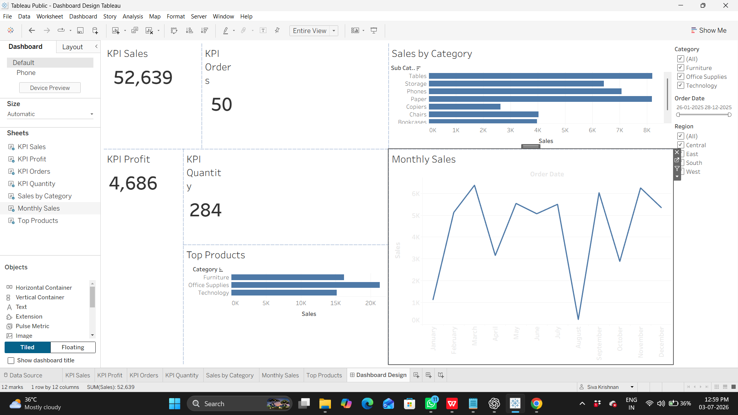
Dashboard Overview
• KPI Cards
• Sales by Category
• Monthly Sales
• Top Products
• Interactive Filters

Slide 5
Key Insights
• Sales performance can be monitored quickly.
• Monthly trend identifies seasonal patterns.
• Category comparison supports product decisions.
• Filters enable interactive business analysis.

Slide 6
Conclusion
• Interactive dashboard successfully created.
• Business users can make faster data-driven decisions.
• Project completed using Tableau Public.

Slide 7
Thank You
Thank You! Questions?

